Slide 1


Simple Algorithms

Slide 2


Objectives
To learn to design algorithms.
To apply problem solving algorithms.
concepts in the design of

Slide 3
Algorithmic thinking
Ability to
  Understand
  Execute
Evaluate and
Let us design algorithms for the following tasks
Create algorithms
Finding the factorial of a given value
Fibonacci sequence generation
Reversing a positive integer digits
Denomination calculation
Finding maximum element in an array
Finding duplicates in an ordered array
Puzzle solving

Slide 4
A Refresher on Factorial
p = 1 = 0!
p = p x 1 = 1!
p = p x 2 = 2!
p = p x 3 = 3!
p = p x 4 = 4!
p = p x 5 = 5!
p = p x 6 = 6!
0! = 1
1! = 1 = 0! x 1
2! = 1 x 2 = 1! x 2
3! = 1 x 2 x 3 = 2! x 3
4! = 1 x 2 x 3 x 4 = 3! x 4
5! = 1 x 2 x 3 x 4 x 5 = 4! x 5
6! = 1 x 2 x 3 x 4 x 5 x 6 = 5! x 6
Do you see a pattern emerging?
Can you write an algorithm employing this pattern?

Slide 5

The pattern!!
p = 1 = 0!
p = p (whose value now is 0!) x 1 = 1!
p = p (whose value now is 1!) x 2 = 2!
p = p (whose value now is 2!) x 3 = 3!
p = p (whose value now is 3!) x 4 = 4!
p = p (whose value now is 4!) x 5 = 5!
p = p (whose value now is 5!) x 6 = 6!

Slide 6
Algorithm for Factorial
Get n for which the factorial to be calculated.
Set product p to 0! and the product count i to 0. (remember there are n products to be counted/calculated)
While less than n products have been calculated repeatedly do
  increment product count i .
  Compute the i^{th} product by multiplying i by the most recent p.
Display the current value of p.

Slide 7
Fibonacci Sequence generation algorithm
The sequence 0, 1, 1, 2, 3, 5, 8, 13, 21, 34, ...
The first two terms 0 and 1 are often chosen by default.
New term (c) = preceding term (a) + term before preceding term (b).
a = 1; b = 0 then the third number is c = a + b = 0 + 1 = 1.
Similarly consecutive terms can be generated iteratively but making necessary assignments to the preceding and term before preceding terms!!

Slide 8
Let us work through
Given the first two numbers a = 0
b = 1
the third number is c = a + b = 0 + 1 = 1.
Now to generate the fourth number the following reassignments have to be made so that we can slide the preceding terms forward.
a = b b = c
the fourth number is c = a + b = 1 + 1 = 2.

Slide 9
Room for Improvement
0, 1, 1, 2, 3, 5, 8, 13, 21, …
a
b
Our new b is our old b + new a which is a+b again!!
Thinking in terms of alternating a's and b's our new a is a+b.
So, we can generate consecutive Fibonacci numbers in pairs using a = a+b and b = a+b.

Slide 10
Given the first two numbers a = 0
Let us check...
b = 1
third and fourth numbers are a = a + b = 0 + 1 = 1
b = a + b = 1(remember a is now 1) + 1 = 2 fifth and sixth numbers are
a = a + b = 1 + 2(remember b is now 2) = 3 b = a + b = 1(remember a is now 3) + 2 = 5
seventh and eighth numbers are
a = a + b = 3 + 5(remember b is now 5) = 8 b = a + b = 1(remember a is now 8) + 5 = 13

Slide 11
Algorithm to Fibonacci Sequence
1.Get n the number of Fibonacci numbers to be generated. 2.Initialize the first two Fibonacci numbers as a = 0 and b = 1 . 3.Initialize count of Fibonacci number generated .
While less than n Fibonacci numbers generated do
  generate the next number as a = a+b.
  generate the next to next number as b = a+b.
  update count of number of Fibonacci numbers generated.
If n is even display all numbers else display all numbers except the last.

Slide 12
Algorithm to reverse digits
Given a positive integer, the task is to reverse the order of its digits
i.e. input = 1234; output = 4321.
1 2 3 4
4 3 2 1
This demands the extraction of each digit from the given number.
How do you extract digits from a given number?

Slide 13
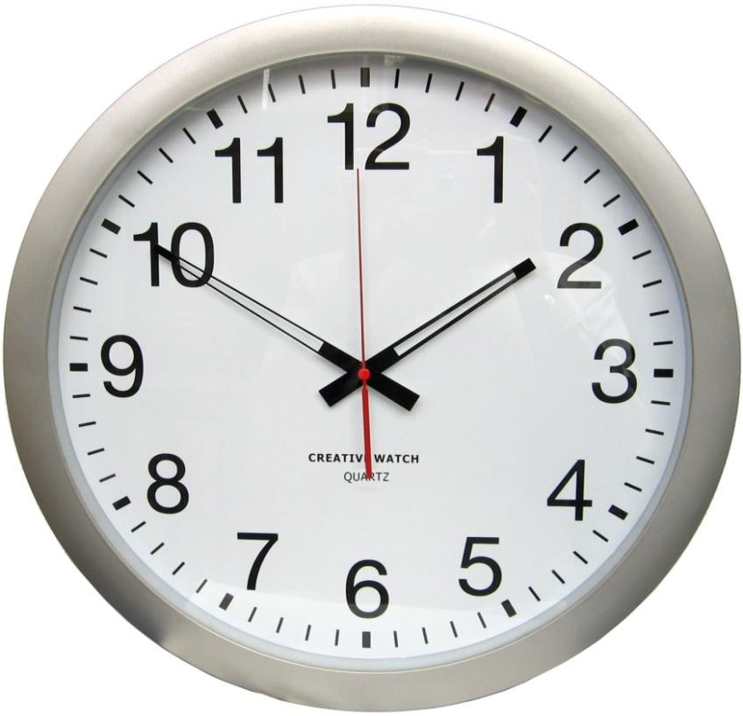
Modulus Operator to extract digits
1234 mod 10 = 4
123 mod 10 = 3
12 mod 10 = 2
1 mod 10 = 1
Quotient
Remainder
Figure: We apply modulus operator when we
interpret time from a clock
While modulus operator extracts digits, does not remove it!! How will you remove
the digits from a number?!

Slide 14
Reversing extracted digits
Say, n = 1234 and nreverse = 0
nreverse = nreverse x 10 + 4 (1234 mod 10 = 4)
nreverse = nreverse x 10 + 3 (123 mod 10 = 3)
nreverse = nreverse x 10 + 2 (12 mod 10 = 2)
nreverse = nreverse x 10 + 1 (1 mod 10 = 1)

Slide 15
Algorithm for digit reversal
Get n the positive integer to be reversed.
Set nreverse to 0 .
While n is greater than zero repeatedly do
  r (remainder) = n mod 10 .
  nreverse = nreverse x 10 + r.
  n = n/10 (gives quotient and thus removes the rightmost digit).
Display the current value of nreverse.

Slide 16
Algorithm for a typical ATM to decide right denomination while dispensing cash (assuming availability of only 100 and 500 Rs. Notes)
Get cash amount .
Set Hs (hundreds) and Fhs (five hundreds) to 0.
If amount < 500 4.Then
Hs = amount/100
Else
Fhs = amount / 500
Hs = (amount mod 500) mod 100
Display the amount, Fhs and Hs.

Slide 17
Algorithm to find maximum number in a set
Maximum is that number which is greater than or equal to all other members in the set.
So, maximum may not be unique.
Say we have the following set of numbers.
8 | 6 | 5 | 15 | 7 | 19 | 21 | 6 | 13
How do we solve this problem? Reflect!!
  We pick a seemingly large number after the first scan!
  We rescan to validate our pick, if we see a larger number we rescan again!!
  May work for shorter sets but not for very large sets!!!

Slide 18
Requirements to automate
Consider the previous example set.
8 | 6 | 5 | 15 | 7 | 19 | 21 | 6 | 13
All numbers need to be examined to establish the maximum (start at the beginning of set, work through number by number till the end of the set is reached).
Comparison of relative magnitude of numbers must be made while working through number by number keeping the starting number, 8, as the temporary maximum number.

Slide 19
Requirements to automate contd---
Consider the previous example set.
8 | 6 | 5 | 15 | 7 | 19 | 21 | 6 | 13
Three situations are possible
  2nd number can be less than the temporary maximum number.
  It could be equal to the temp. max. no.
  It could be greater than the temp. max. no.
Situations 1 & 2, the temp. max. no. is unchanged. Situation 3, the 2nd number becomes the new temp. max. no.
This has to be repeated till the end of the set.

Slide 20
Algorithm to find maximum number
Get an array a[0,...n-1] of n elements where n ≥ 1.
Set temporary maximum max to first array element i.e. a[0].
While less than n array elements have been considered repeatedly do
  If next element greater than current maximum then assign it to max.
Return the maximum max for the given array.

Slide 21
Algorithm to find duplicates in ordered array
Given the following array
2 | 2 | 8 | 15 | 23 | 23 | 23 | 6 | 13
The array after duplicate removal becomes
2 | 8 | 15 | 23 | 6 | 13
What has happened to the given ordered array?
What, do you think, is required to achieve this?

Slide 22
Except the first element, all unique elements have shifted their positions to as far to left as possible in the array.
A pair wise comparison to identify unique elements must be there and it leads to two situations.
  A pair of duplicates has been encountered.
  Two elements are different.

Slide 23
Consider the following case.
1 2 3 4
5
6
1
2
3
4
15 | 23 | 23 j | 23 | 6 i | 13
15 | 23 | 6 | 13
15 23 23 23 6 13
The position in the array where each most recently encountered unique element must be located is determined at each instance by the number of unique elements met so far!
Can be modeled by the assignment a[j] = a[i].
While all adjacent pairs have not been compared do
if they are not equal, shift the rightmost element to the array position determined by the current unique element count.

Slide 24
Initialization choices: first element should remain untouched; first two elements may be identical too!
  i = 1 and is a[i] equal to a[i+1]?
  i = 2 and is a[i-1] equal to a[i]? (direct termination)
The assignment a[j] = a[i] should be invoked only when duplicates are encountered.This can be realized using a loop that compares pair of elements until a duplicate is encountered.
while a[i-1] is not equal to a[i] do i = i +1
Loop can be terminated with a condition i<n to ensure that termination works well even if there are no duplicates .

Slide 25
Algorithm to find duplicates
Get an array a[1,...n] of n elements where n ≥ 1.
Set loop index i to 2 to allow correct termination.
Compare successive pairs of elements until a duplicate is encountered then set unique element count j .
While all pairs have not been examined do a)If next not duplicates then
  Add one to unique element count j.
  Move later element of pair to array position determined by the unique element count j.
Return the array.

Slide 26
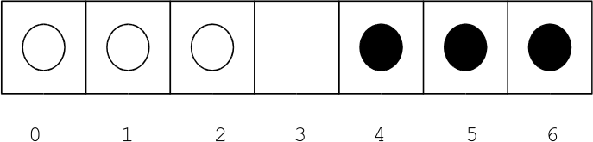
Eg. A playing board
A playing board consists of 7 squares in a row numbered 0 to 6. Initial positions of three white and three black pieces are as shown below. Pieces can either move by sliding into an adjacent empty square or by jumping a single adjacent piece into the empty square beyond. Aim: Swap the positions of the black and white pieces
Figure: Initial configuration of the puzzle

Slide 27
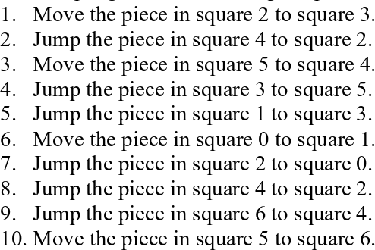
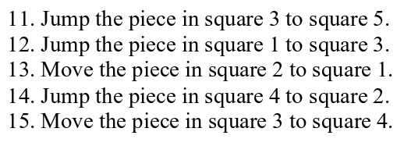
How many instructions your algorithm has?
Did you observe that there may be varying number of instructions still all solving the puzzle?
Needless to say, do you realize that lesser of number of instructions solving the puzzle is often preferred?

Slide 28

Design an algorithm to convert a decimal integer to its corresponding octal representation.
Given two positive non-zero integers n and m, design an algorithm for finding their greatest common divisor (gcd).
Design an algorithm that re-arranges elements in a given array such that they appear in reverse order.
Given a set of n students’ exam marks (in the range 0 to 100), design an algorithm to count the number of students who obtained each possible mark.

Slide 29

Write an Algorithm for
Step1: Start
Step2: Read/input x
Step3: If X Less than zero then F=-X
Step4: if X greater than or equal zero then F=X
Step5: Print F
Step6: End

Slide 30
Design an algorithm with a natural number, n, as its input which calculates the following formula and writes the result in the standard output: S = ½ + ¼ + ... +1/n
1. Start
2. Read n
3. I ← 2 and S ← 0
4. S= S + 1/I
5. I ← I + 2
6. If (I <= n) then go to line 4
else write S in standard output
7. End

Slide 31

What has been described?
Applying problem solving algorithms.
concepts in the design of
Critical observation to look for patterns that help solving problems.
Credits
CS4edu Purdue
http://raptor.martincarlisle.com
Theinternationallocal.blogspot.com
Kordemsky/Paul curzon
How to solve it by computer - Dromey
Google images

